Slide 1
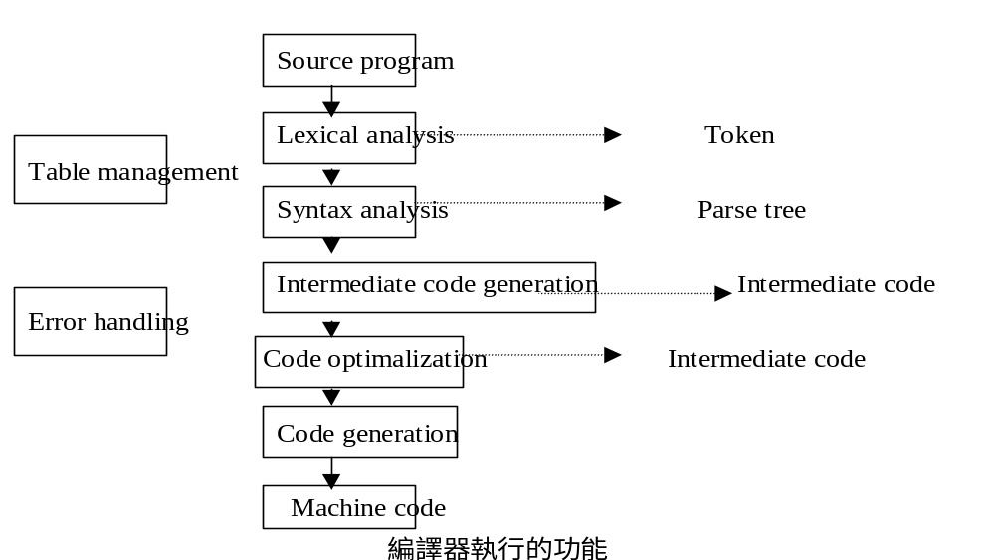
CHAPTER 5 Compiler
5.1 Basic Compiler Concepts

Slide 2
Basic Compiler Concepts
1. Lexical Analysis (Lexical Analyzer 或Scanner)
Read the source program one character at a time, carving the some program into a sequence of atomic units called token.
Token (token type, token value)

Slide 3
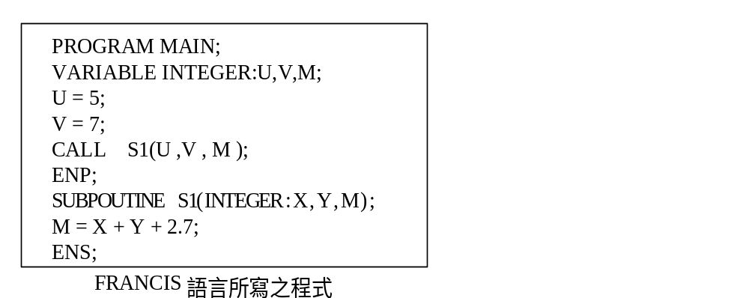
Basic Compiler Concepts

Slide 4
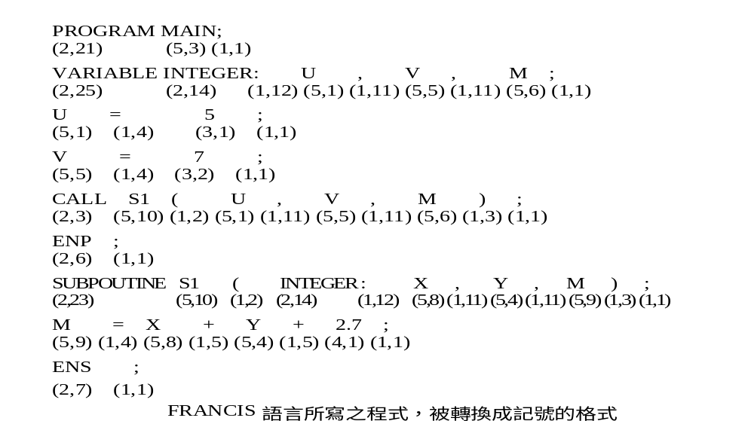
Basic Compiler Concepts

Slide 5
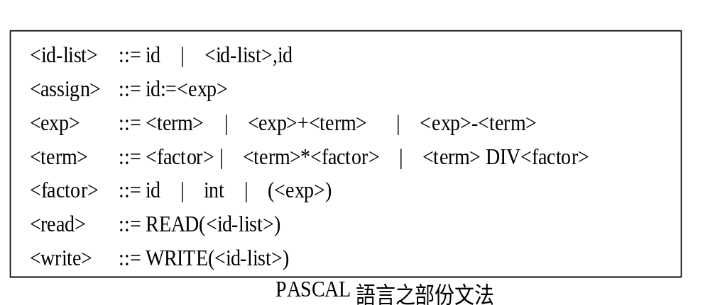
Basic Compiler Concepts
2. Syntax Analysis (Syntax Analyzer 或Parser)
The grammar specified the form, or syntax, of legal statements in the language.

Slide 6
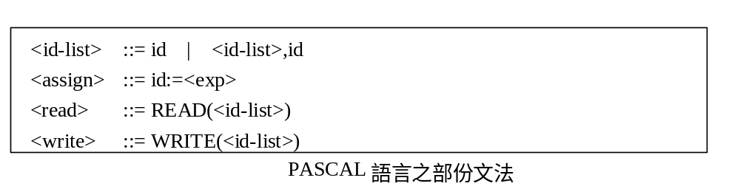
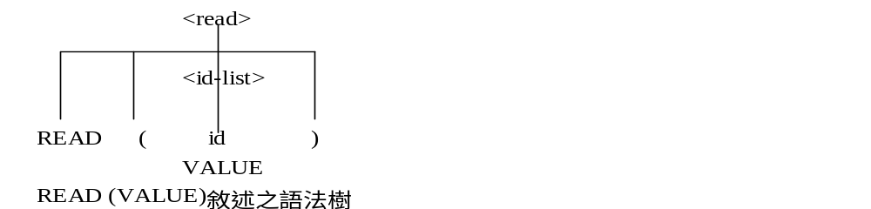
Basic Compiler Concepts
Parse Tree

Slide 7
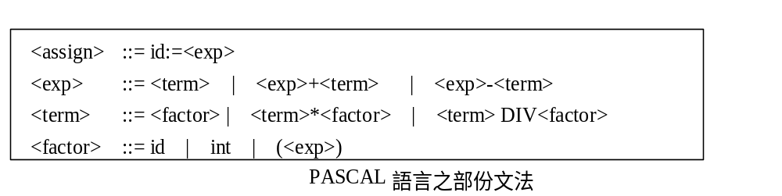
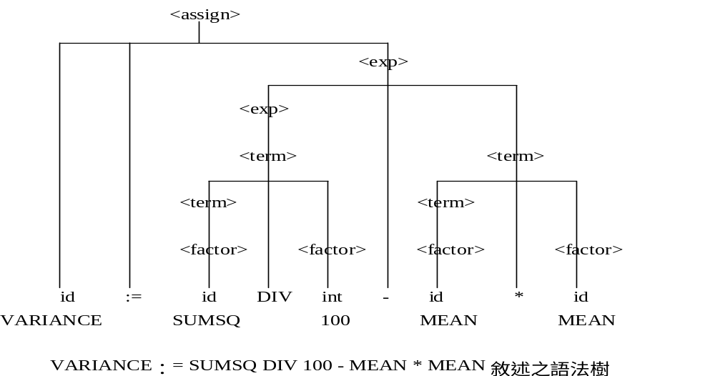
Basic Compiler Concepts

Slide 8
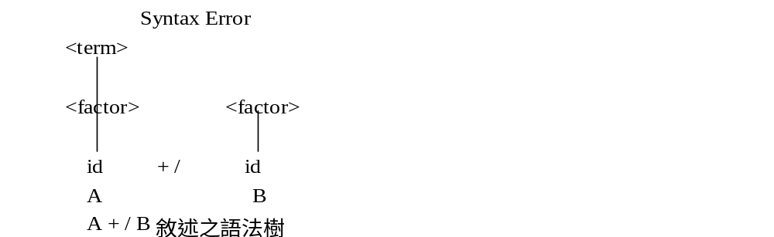
Basic Compiler Concepts

Slide 9
Basic Compiler Concepts
3. Intermediate Code Generation
Three Address Code
(operator，operand1，operand2，Result)
A=B+C (+，B，C，A)
SUM：=A/B*C，可以被分解成
T1=A/B (/，A，B，T1)
T2=T1*C (*，T1，C，T2)
SUM=T2 (=，T2， ，SUM)

Slide 10
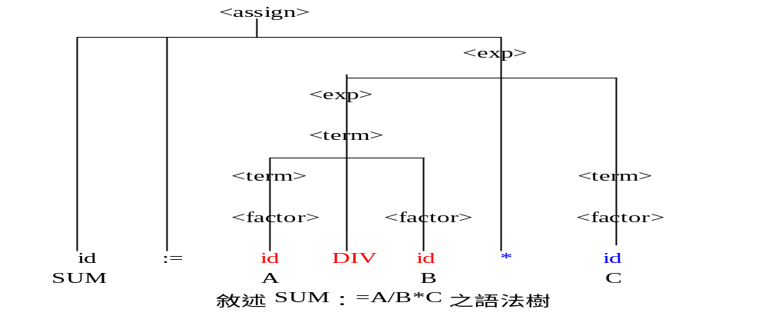
Basic Compiler Concepts
SUM：=A/B*C，可以被分解成
T1=A/B (/，A，B，T1)
T2=T1*C (*，T1，C，T2)
SUM=T2 (=，T2， ，SUM)

Slide 11
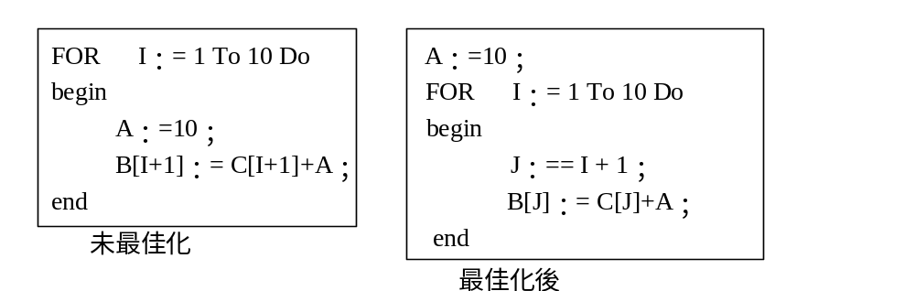
Basic Compiler Concepts
4. Code Optimization
Improve the intermediate code (or machine code), so that the ultimate object program run fast and/or takes less space

Slide 12
Basic Compiler Concepts
5. Code Generation
* Allocate memory location
* Select machine code for each intermediate code
* Register allocation: utilize registers as efficiently as possible
(+，B，C，A) 我們可以得到
    MOV AX,B
    ADD AX,C
    MOV A,AX

Slide 13
Basic Compiler Concepts
    SUM：=A/B*C
(/，A，B，T1) MOV AX,A
DIV B
MOV T1,AX
(* ，T1，C，T2) MOV AX,T1
MUL C
MOV T2,AX
(=，T2， ，SUM) MOV AX,T2
MOV SUM,AX

Slide 14
Basic Compiler Concepts
(/，A，B，T1) MOV AX,A
DIV B
MOV T1,AX
(* ，T1，C，T2) MOV AX,T1
MUL C
MOV T2,AX
(=，T2， ，SUM) MOV AX,T2
MOV SUM,AX
再作一次碼的最佳化

Slide 15
Basic Compiler Concepts
6. Table Management and Error Handling
Token, symbol table, reserved word table, delimiter table, constant table,… etc.
* 五大功能之每一功能均做一次處理，如此就是五次處理。
* 也可以把幾個功能合併在同一次處理。
* 它至少是二次處理。

Slide 16
Grammar
5.2 Grammar
1. Grammar
Backus Naur Form Grammar consists of a set of rules, each which defines the syntax of some construct in the programming language.
Terminal symbol
Non-terminal symbol

Slide 17
Grammar
2. Parse Tree (Syntax Tree)
It is often convenient to display the analysis of source statement in terms of a grammar as a tree.

Slide 18
Grammar
3. Precedence and associativity
Precedence *, / > +, -
Associativity a + b + c ( (a + b) + c)
Left associativity
Right associativity

Slide 19
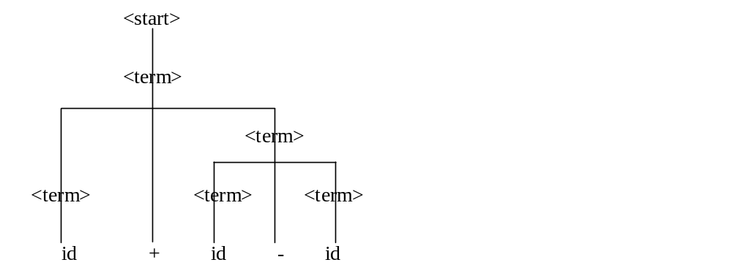
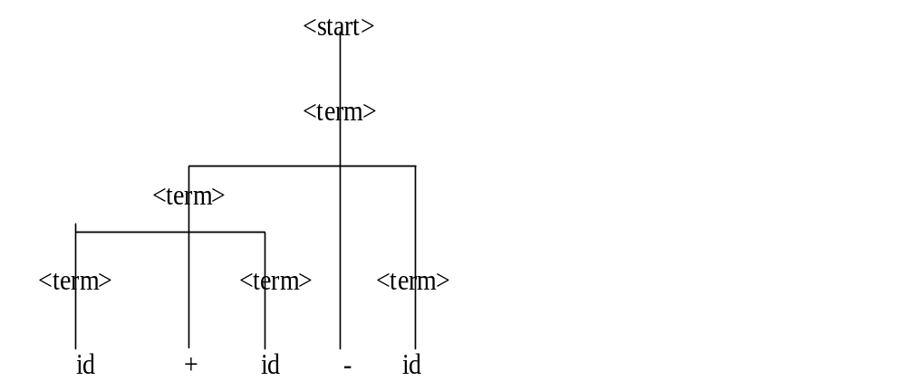
Grammar
4. Ambiguous Grammar
There is more than one possible parse tree for a given statement.

Slide 20
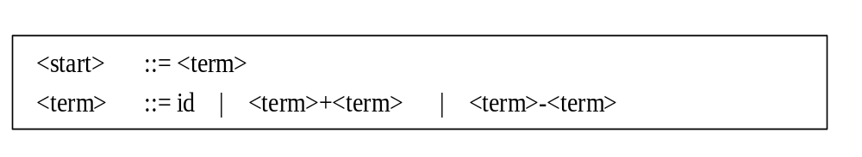
Grammar
Ambiguous Grammar

Slide 21
Lexical Analysis
5.3 Lexical Analysis
Program內有下列幾類Token:
a. Identifier
b. Delimiter
c. Reserved Word
d. Constant integer, float, string
1. Identifier
<ident> ::= <letter> | <ident> <letter> | <ident> <digit>
<letter>::= A | B | C | …..
<digit>::= 0 | 1 | 2 |…..
Multiple character token

Slide 22
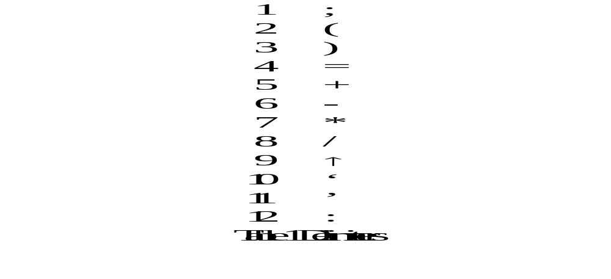
Lexical Analysis
2. Token and Tables

Slide 23
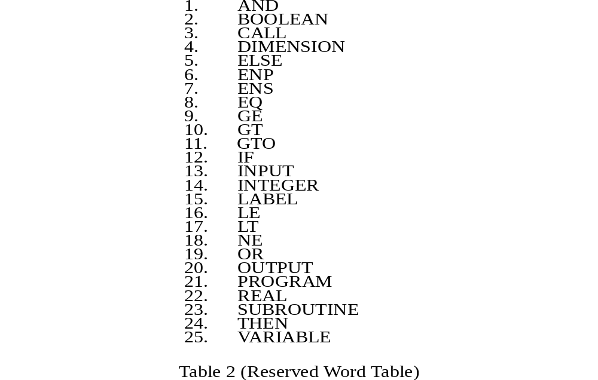
Lexical Analysis
2. Token and Tables

Slide 24


Lexical Analysis
2. Token and Tables

Slide 25
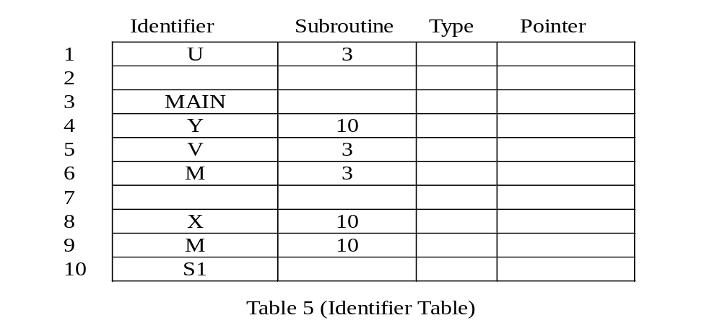
Lexical Analysis
2. Token and Tables

Slide 26
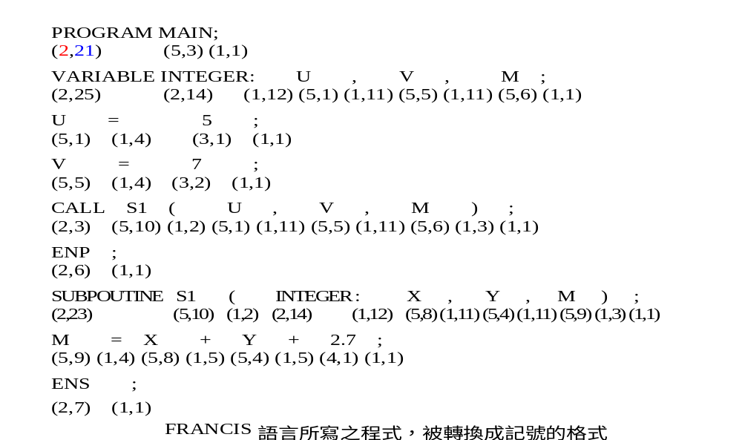
Lexical Analysis
Token Specifier
(Token Type, Token Value)
Table Entry
2. Token and Tables

Slide 27
Syntax Analysis
5.4 Syntax Analysis
1. Building the Parse Tree
a. Top down method
Begin with the rule of the grammar, and attempt to construct the tree so that the terminal nodes match the statements being analyzed.
b. Bottom up method
Begin with the terminal nodes of the tree, and attempt to combine these into successively high level nodes until the root is reached.

Slide 28
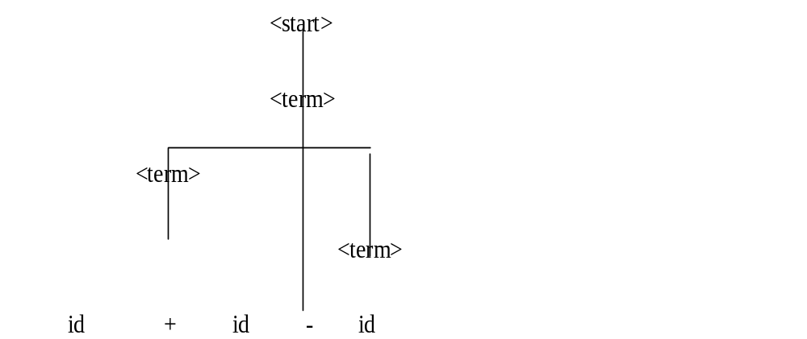
Syntax Analysis
* Top down method
Begin with the rule of the grammar, and attempt to construct the tree so that the terminal nodes match the statements being analyzed.

Slide 29
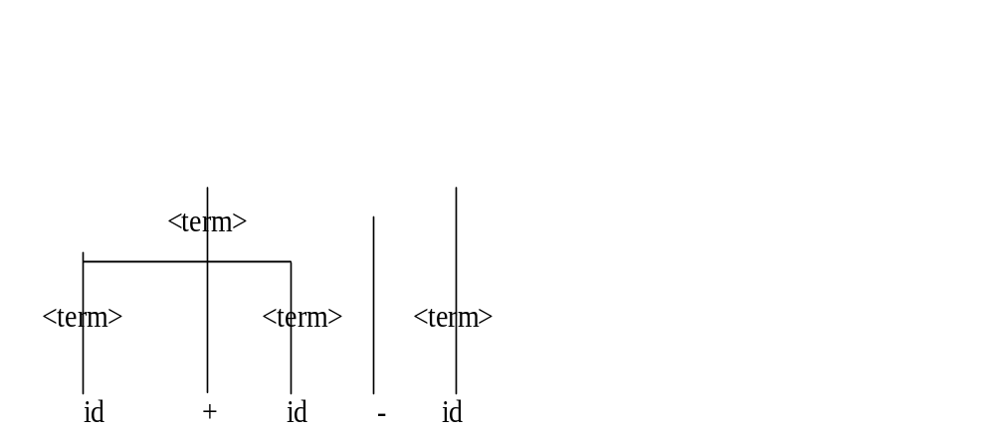
Syntax Analysis
* Bottom up method
Begin with the terminal nodes of the tree, and attempt to combine these into successively high level nodes until the root is reached.

Slide 30
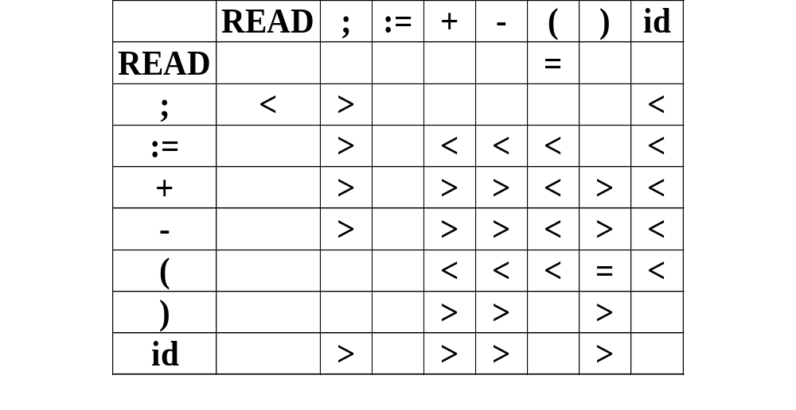
Syntax Analysis
2. Operator Precedence Parser
Bottom up parser
Precedence Matrix

Slide 31
Syntax Analysis
Stack input
< READ(id);
<READ (id)
<READ = ( id)
<READ = ( <id )
<READ = ( <id> )
<READ = ( = id-list )
<READ = ( = id-list ) >
read

Slide 32
Syntax Analysis
Stack input
< id + id - id
<id + id - id
<id> + id - id
<term + id - id
<term + < id > - id
<term + term > - id
<term - < id
<term - <id>
<term - term>
term

Slide 33
Syntax Analysis
Stack input
< id + id - id
<id + id - id
<id> + id - id
<term + id - id
<term + < id > - id
<term + term > - id
<term - < id
<term - <id>
<term - term>
term
Generally use a stack to save tokens that have been scanned but not yet parsed

Slide 34
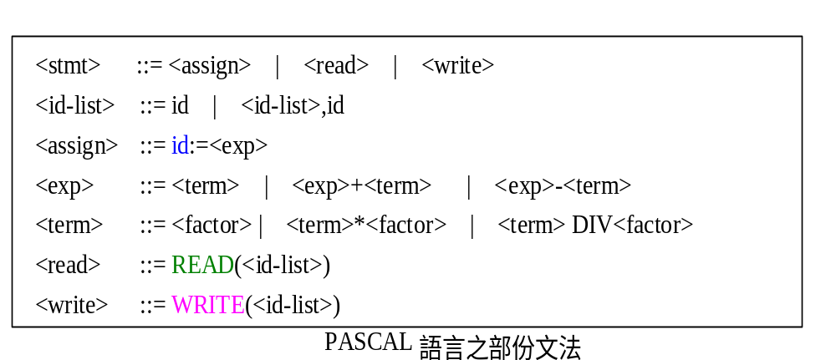
Syntax Analysis
3. Recursive Descent Parser
Top down method
a. leftmost derivation
It must be possible to decide which alternative to used by examining the next input token
<stmt> id, READ, WRITE

Slide 35
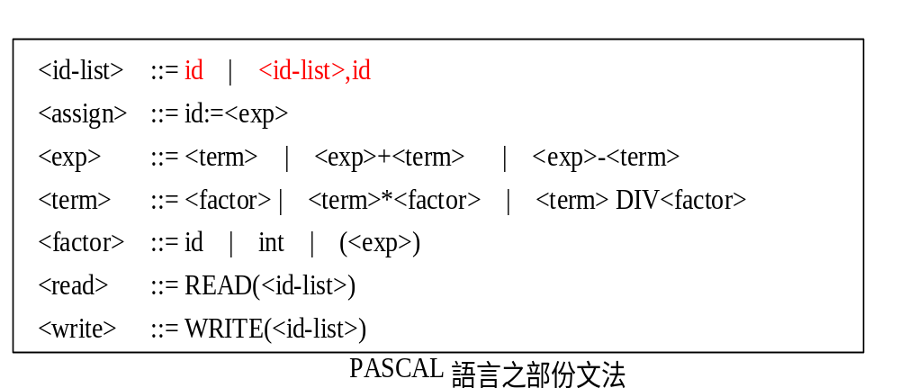
Syntax Analysis
b. left recursive
Top down parser can not be used with grammar that contains left recursive. Because unable to decide between its alternatives tokens.
both id and <id-list> can begin with id.

Slide 36
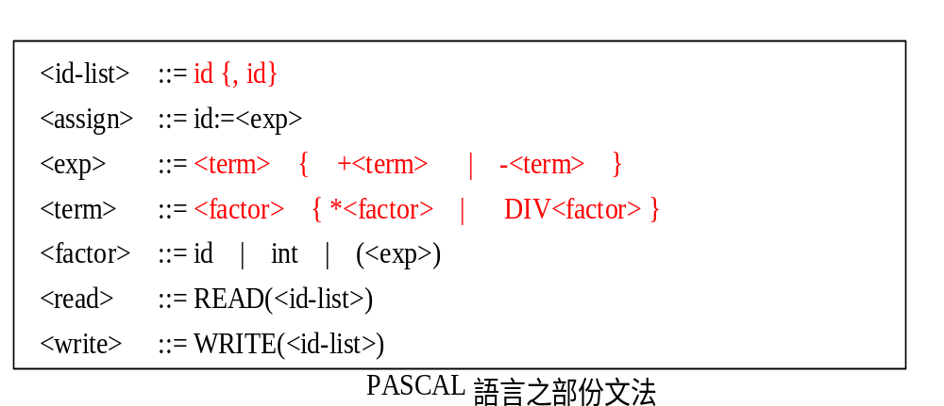
Syntax Analysis
Modified for recursive descent parser

Slide 37
Code Generation
5.5 Code Generation
When the parser recognizes a portion of the source program according to some rule of grammar, the corresponding routine is executed.
Semantic Routine or Code Generation Routines
1.Operator precedence parser
When sub-string is reduced to nonterminal
2.Recursive descent parser
When procedure return to its caller, indicating success.

Slide 38
Code Generation
<term> ::= <term>1 + <term>2
MOV AX, <term>1
ADD AX, <term>2
MOV <term>, AX
<term> ::= <term>1 - <term>2
MOV AX, <term>1
SUB AX, <term>2
MOV <term>, AX
<term> ::= id
add id to <term>

Slide 39
Code Generation
直接產生Assembly instructions或Machine codes太細
故先翻成Intermediate Form

Slide 40
Intermediate Form
5.6 Intermediate Form
Three Address Code (Quadruple Form)
(operator，operand1 ， operand2 ， Result)
<term> ::= <term>1 + <term>2
(+, <term>1, <term>2, <term>)
<term> ::= <term>1 - <term>2
(-, <term>1, <term>2, <term>)
<term> ::= id
add id to <term>

Slide 41
Intermediate Form
Variance := sumsq DIV 100 - mean * mean
(DIV, sumsq, #100, i1)
(*, mean, mean, i2)
(-, i1, i2, i3)
(:=, i3, , variance)

Slide 42
Machine Independent Compiler Features
5.7 Machine Independent Compiler Features
1. Storage Allocation
a. Storage Allocation
* Static Allocation
Allocate at compiler time
* Dynamic Allocation
Allocate at run time
Auto : Function call STACK
Controlled : malloc( ), free( ) HEAP

Slide 43
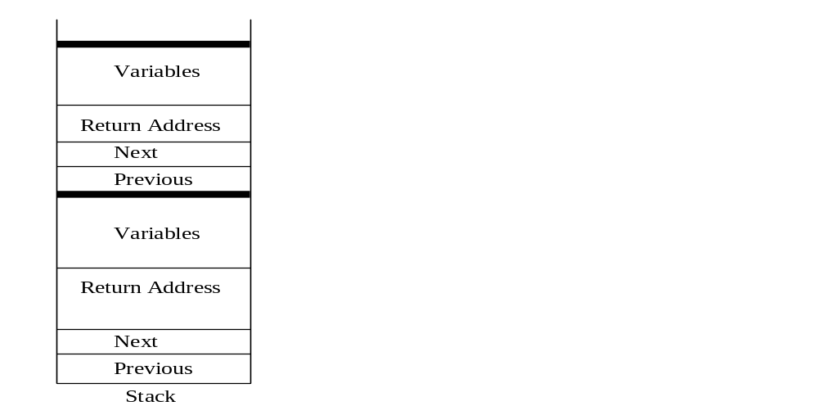
Machine Independent Compiler Features
2. Activation Record
Each function call creates an activation record that contains storage for all the variables used by the function, return address,… etc.

Slide 44
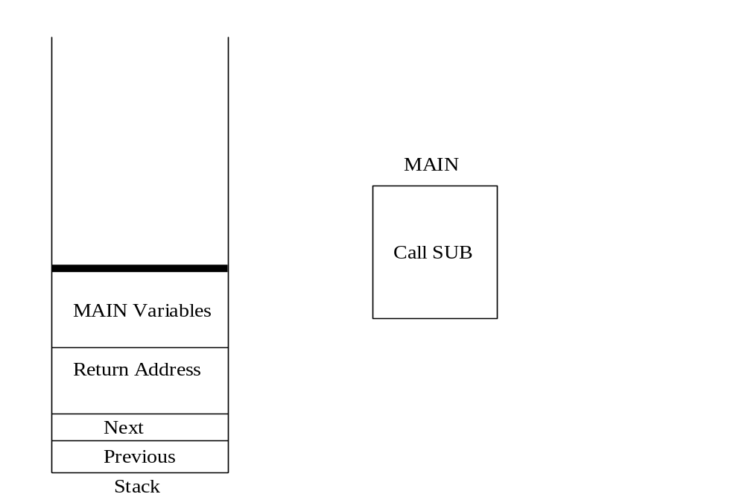
Machine Independent Compiler Features
Activation Record
To OS
MAIN

Slide 45
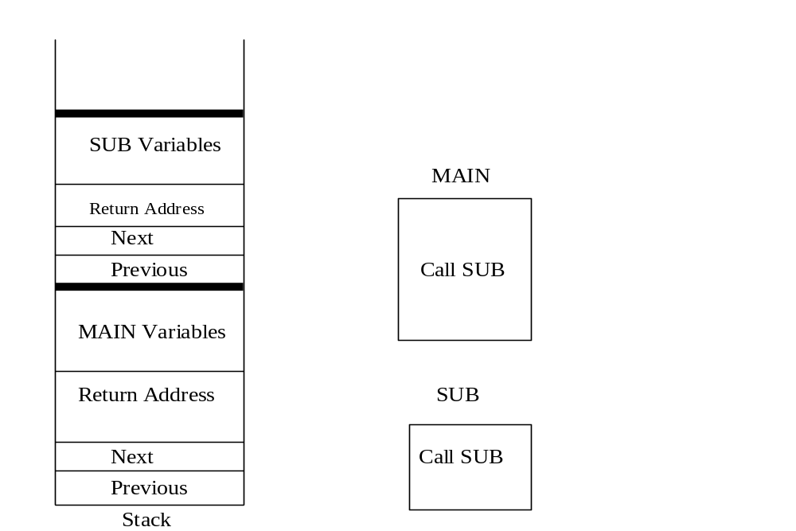
Machine Independent Compiler Features
Activation Record
To OS
SUB
MAIN

Slide 46
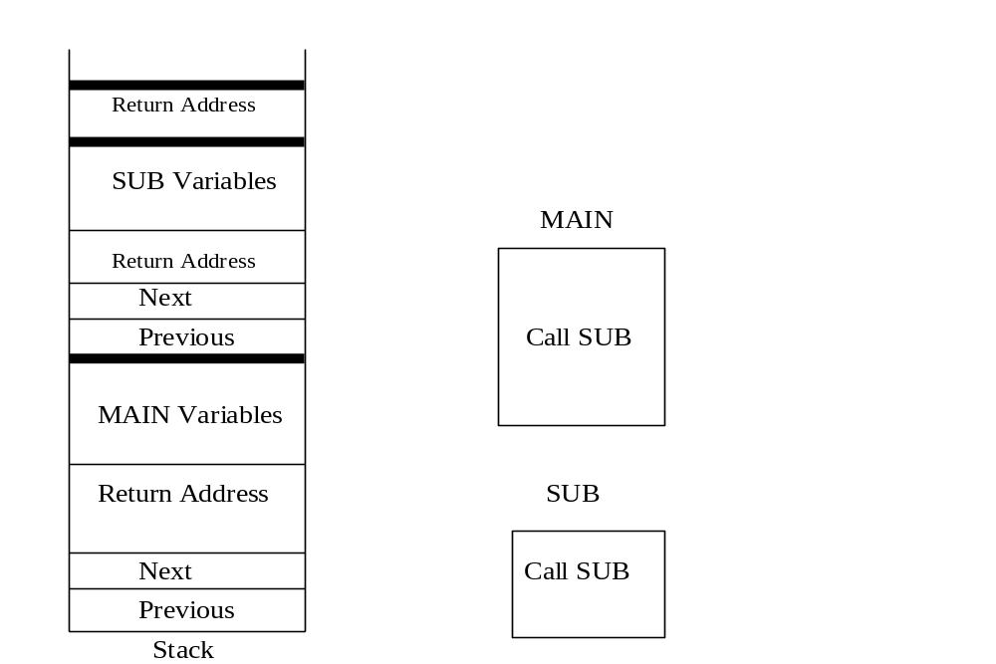
Machine Independent Compiler Features
Activation Record
SUB
To OS
SUB
MAIN

Slide 47
Machine Independent Compiler Features
3. Prologue and Epilogue
The compiler must generate additional code to manage the activation records themselves.
a. Prologue
The code to create a new activation record
b. Epilogue
The code to delete the current activation record

Slide 48
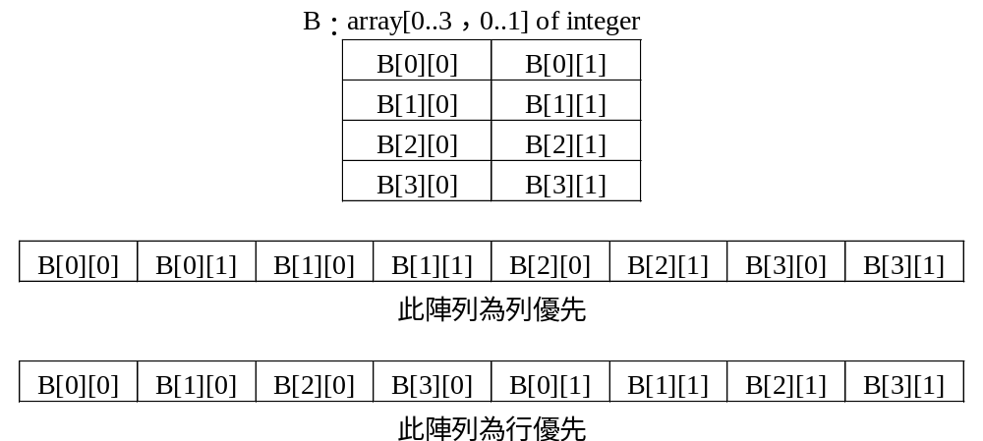
Machine Independent Compiler Features
4. Structure Variables
Array, Record, String, Set …..

Slide 49
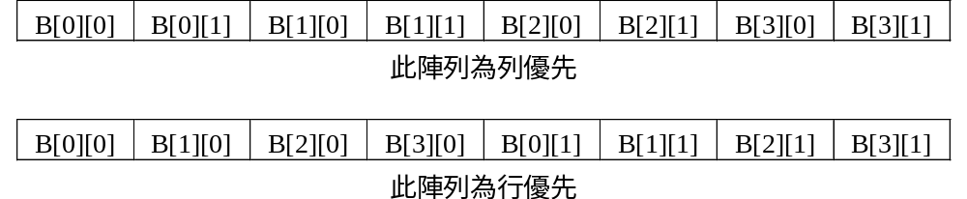
Machine Independent Compiler Features
Type B[a-b] [c-d]
Address of B[s][t]
Row Major
[(s - a) *(d - c +1) + (t - c) ] * sizeof(Type) + Base address
Column Major
[(t - c) *(b - a +1) + (s - a) ] * sizeof(Type) + Base address

Slide 50
Machine Independent Compiler Features
5. Code Optimization
For I:= 1 to 10
Begin
x[I, 2*J-1] := T[I, 2*J];
Table[I] := 2**I;
END
T1:= 2 *J;
T2 := T1 - 1;
K := 1;
For I:= 1 to 10
Begin
x[I, T2] := T[I, T1];
K := K * 2;
Table[I] := K;
END
a. Common Sub-expression
b. Loop In-variants
c. Reduction in Strength

Slide 51
Compiler Design Option
5.8 Compiler Design Option
1. Interpreter
An interpreter processes a source program written in a high level language, just as a compiler does. The main difference is that interpreters execute a version of the source directly.
An interpreter can be viewed as a set of functions, the execution of these functions is driven by the internal form of the program.

Slide 52
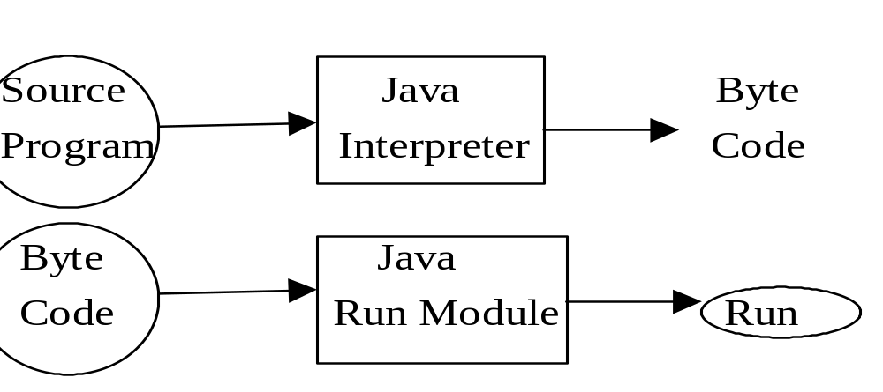
Compiler Design Option
2. P Code Compiler
* P Code 就是Byte Code,是一種與機器無關(Machine Independent)的語言
* 可以跨平台在不同種類的電腦內執行。

Slide 53
Compiler Design Option
3. Compiler-Compiler
A software tool that can be used to help in the task of compiler construction.
Uses Finite State Automata
YACC Parser Generator
LEX Scanner Generator
Unix

Slide 54
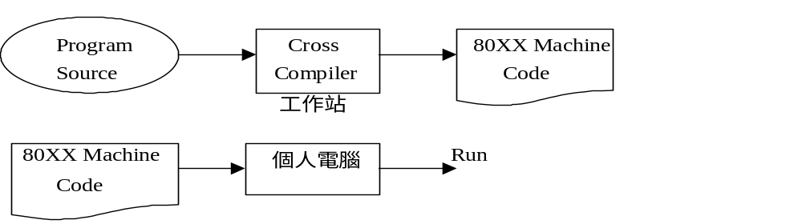
Compiler Design Option
4. Cross Compiler

